Slide 1
Microsoft Power Platform
Notes:
Hi, Welcome to Microsoft Power Platform

Slide 2
Day 5: Power Packed Day with Power Platform and MS Teams

Slide 3

Agenda
Introducing Dataverse for Teams
Make Power Apps a MS Teams App
Integrate Power Automate with MS Teams
Integrate Power Virtual Agents with MS Teams
Use case: Leave Management Application

Slide 4
Customize a SharePoint list or library form
Notes:
https://docs.microsoft.com/en-us/powerapps/maker/canvas-apps/customize-list-form

Slide 5
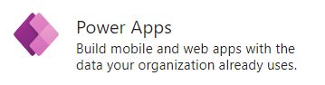
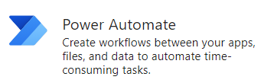
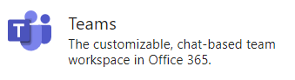
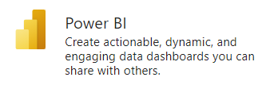
A single hub where in you can…
Integrate your business apps together
Design your process flows
Get report insights
Collaborate with colleagues

Slide 6
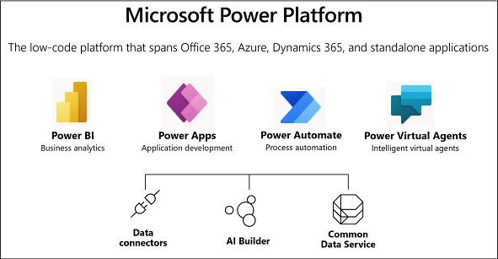
What is Power Platform?
4 Products
Features
Image source: https://docs.microsoft.com/en-us/powerapps/maker/common-data-service/data-platform-intro

Slide 7
A short history

Slide 8
From where is started?
Dataflex
July 2020
Project Oakdale
July / August 2020
Dataverse for Teams
November 2020

Slide 9
Microsoft Dataverse for Teams
Support to build low-code and no-code apps, flows, and chatbots
Core data capabilities
Storage, rich data types
A new visual editor
Inclusion in most existing Teams licenses
Storage of 2 GB per team
Support for up to 500 teams

Slide 10
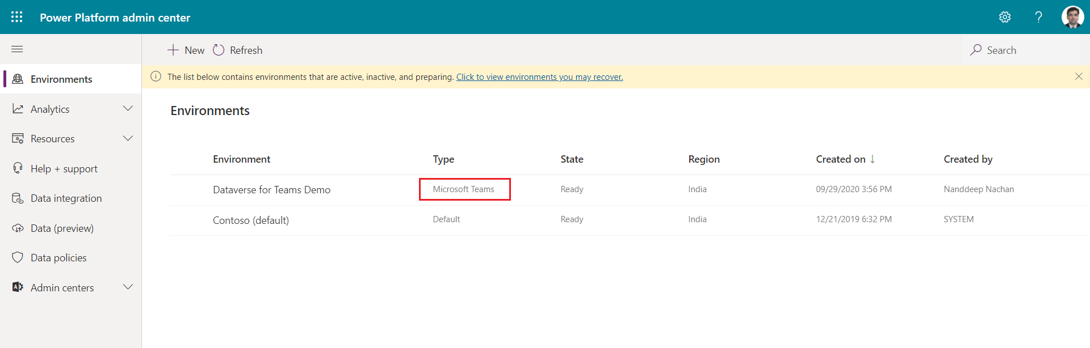
Dataverse for Teams environment

Slide 11
Environment lifecycle
Backup
Restore
Copy
Create
Delete
Reset
Upgrade

Slide 12
Microsoft Teams and Power Apps integration

Slide 13
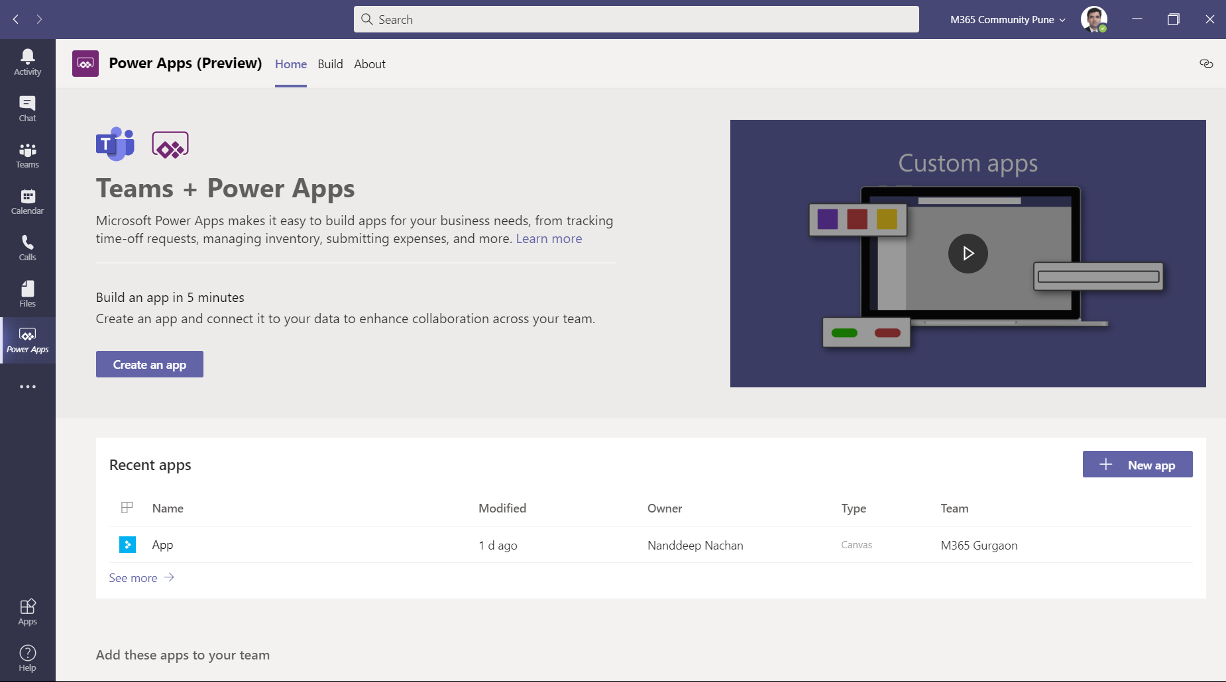
Build and deploy apps inside Teams

Slide 14
Integrate Power Automate with MS Teams

Slide 15
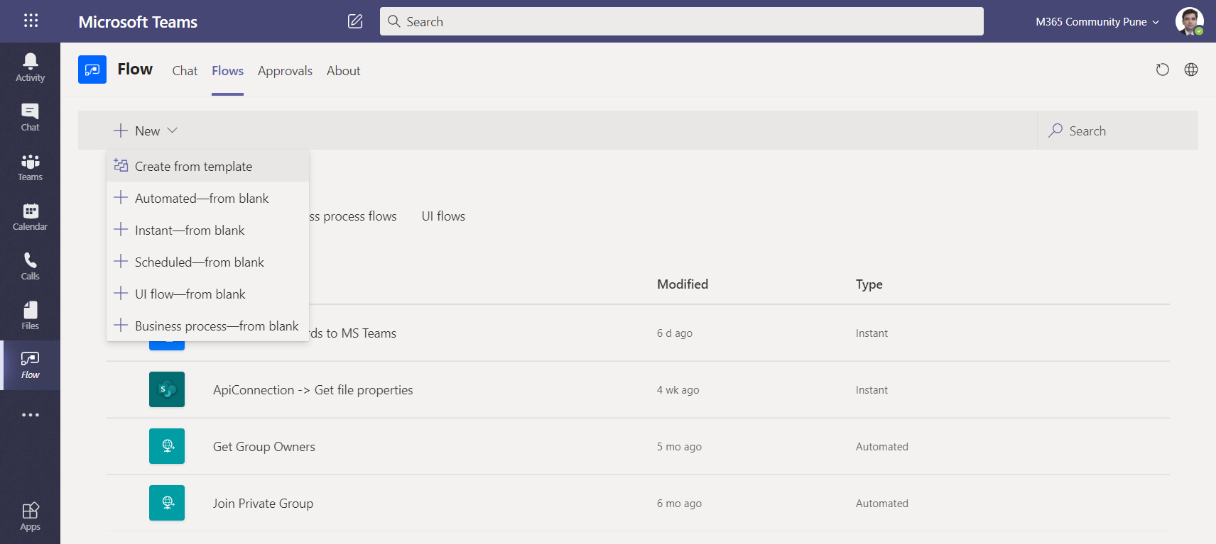
Build and deploy flows inside Teams

Slide 16
Integrate Power Virtual Agents with MS Teams

Slide 17
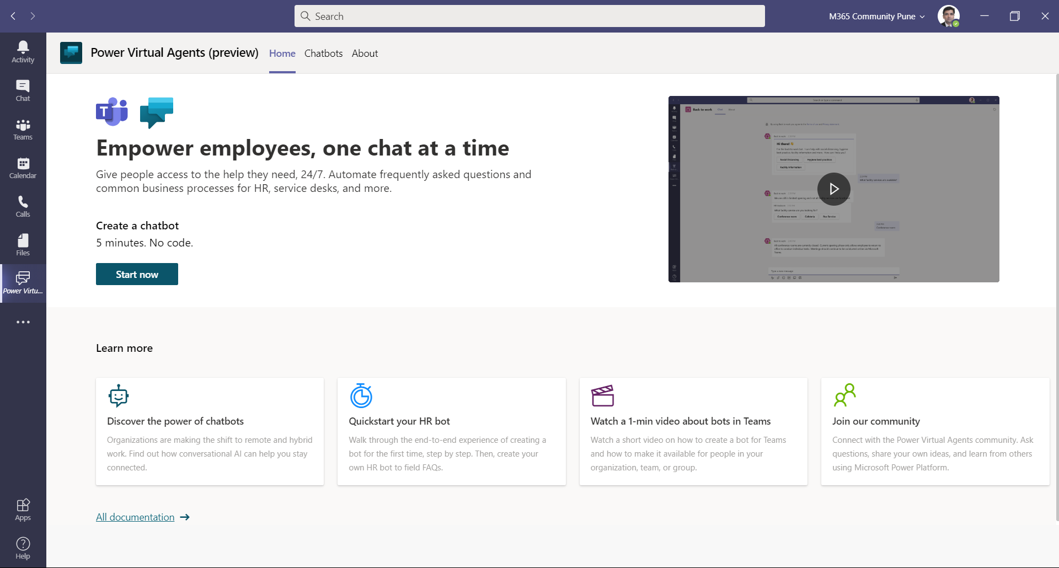
Build and deploy bots inside Teams

Slide 18
Thank you!

